Slide 1

Indian Institute of Information Technology, Nagpur
July to December 2024
Multi-Modal Sentimental Analysis
Integrating Text, Audio, and Image Data for Emotion Detection
Presentated By : Sohan Meshram (BT22CSD013)
Srushti Konnuri (BT22CSD059)
Aryan Chandolia (BT22csd015)
Supervised by:
Mrs. Varsha Kushwah

Slide 2
Multi-Modal sentiment analysis
The primary objective of this project is to develop a multi-modal sentiment analysis model that integrates text, image, and audio data to provide a comprehensive and accurate sentiment prediction. Traditional unimodal approaches often miss contextual clues or misinterpret sentiments, especially when dealing with sarcasm, ambiguous tones, or conflicting signals across different modalities. By leveraging the strengths of each modality, the proposed system aims to overcome these limitations.
Our goal is to extract meaningful features from each input type: text embeddings from natural language, image-based emotion detection, and audio features like tone and pitch. These features will be fused to create a unified sentiment prediction model. The focus is on enhancing accuracy, improving robustness, and addressing real-world challenges such as data misalignment and incomplete information. This model will be applicable in areas like customer feedback analysis, social media monitoring, and multimedia content analysis, providing deeper insights into user sentiment.

Slide 3
Project Overview
Objective:
To create a robust system for detecting sentiment using multiple modalities (text, audio, and image).
Why Multi-Modal?:
Text: Captures semantic and contextual meaning.
Audio: Adds tonal and speech-based emotional cues.
Image: Includes facial and visual context for better sentiment understanding.
Applications:
Social media monitoring, customer service feedback, and healthcare.

Slide 4

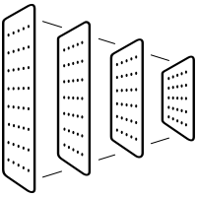





Tools and Techniques Used
Languages:
Python
Libraries:
Text: NLTK, TensorFlow
Audio: Librosa, TensorFlow
Image: OpenCV, Keras
Models Used:
LSTM for Text and Audio
CNN for Images
Fusion Technique:
Late Fusion with Priority-Majority Strategy

Slide 5
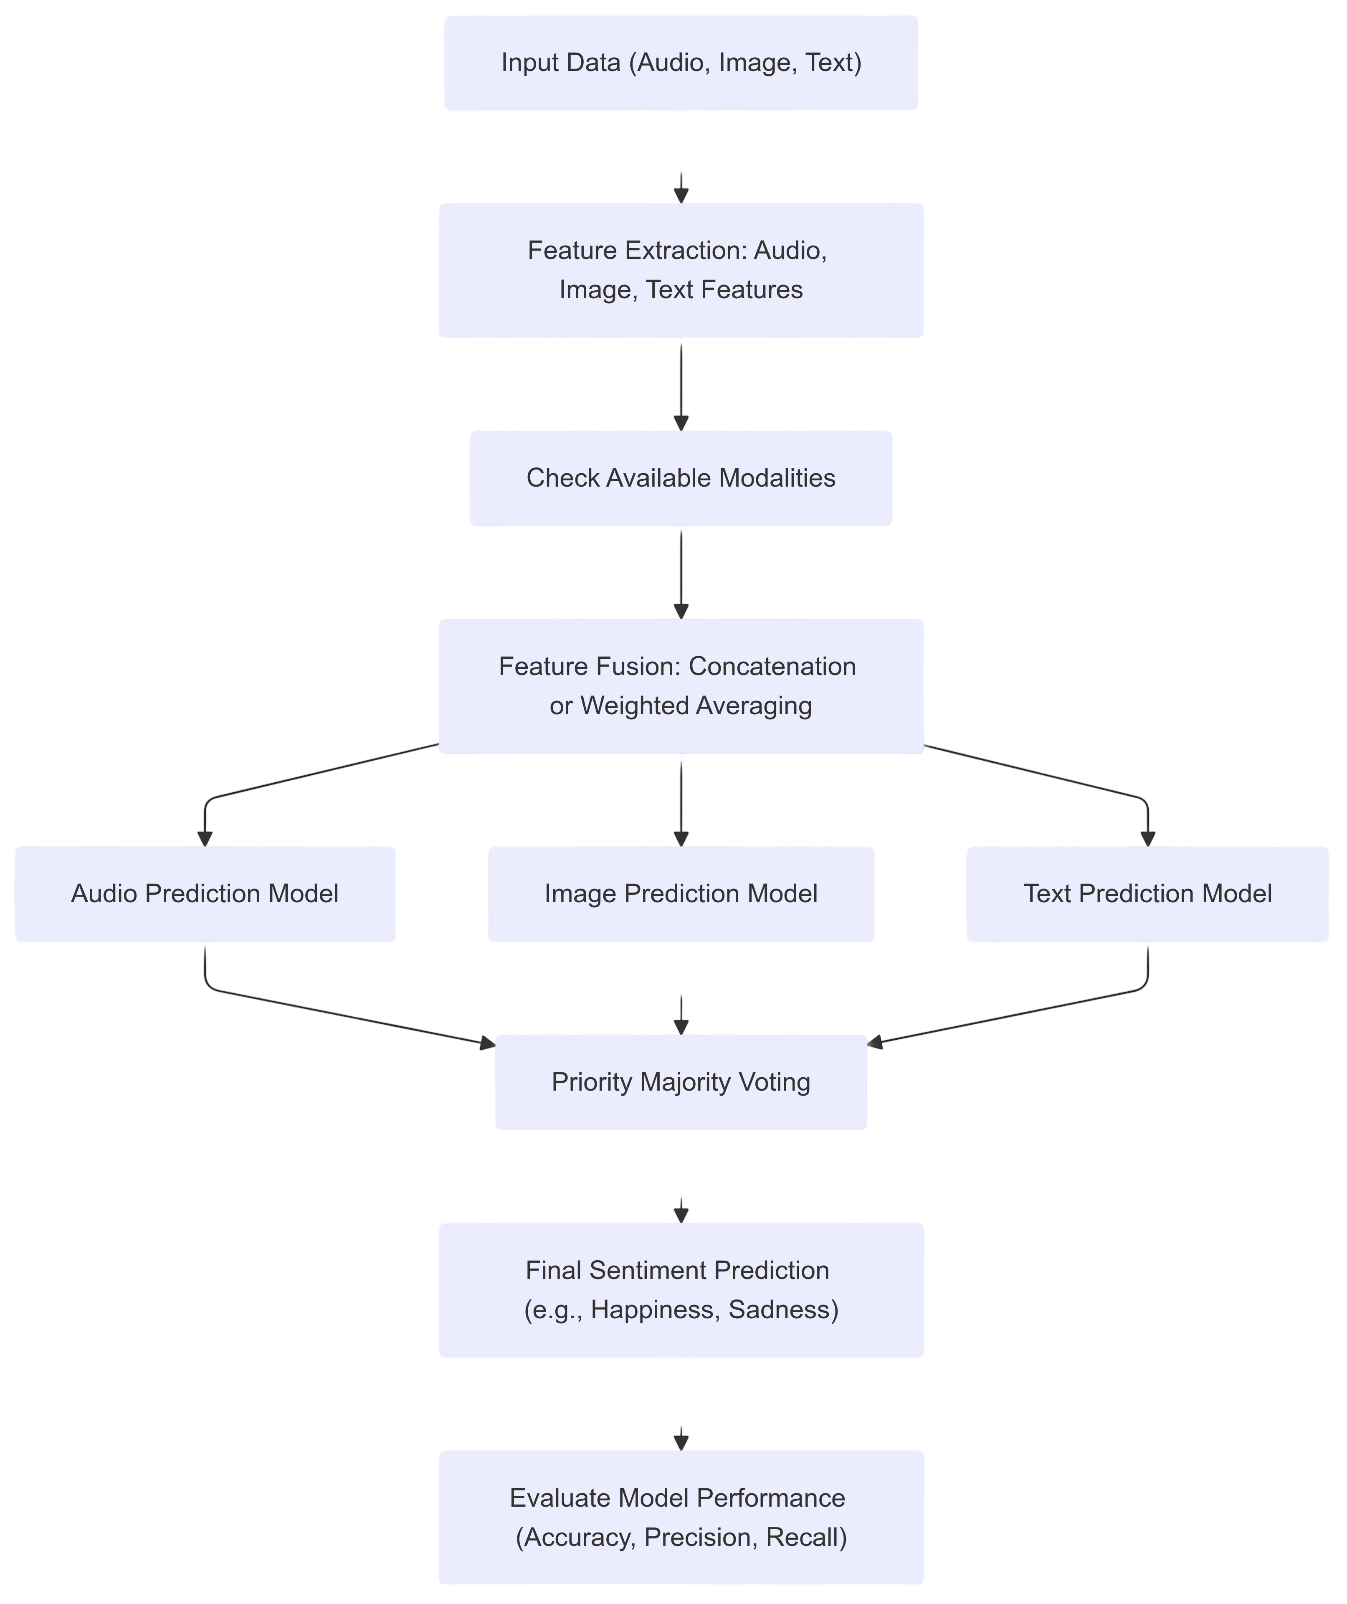
Model Workflow
Input Data:
Text sentences, audio files, and images.
Preprocessing:
Tokenization, feature extraction, resizing.
Individual Models:
Text processed with LSTM.
Audio analyzed via MFCCs and LSTM.
Image processed with CNN for facial sentiment detection.
Fusion:
Combining predictions from all models using late fusion.

Slide 6
Text-Based Analysis
Overview
This model analyzes textual data to detect sentiment through linguistic patterns.
Uses an ensemble approach for enhanced accuracy.
Preprocessing Steps
Size of Dataset : training : (43410) , testing : (5427) having 7 type of emotions
Noise Removal: Eliminated stopwords, punctuation, and special characters.
Tokenization: Converted sentences into word tokens.
Embedding: Applied TF-IDF and Word2Vec to represent tokens as numerical vectors.
Performance
Accuracy: 64%.
Strength: Good at detecting sentiment in well-structured text.
Limitation: Struggles with sarcasm or ambiguous language.

Slide 7
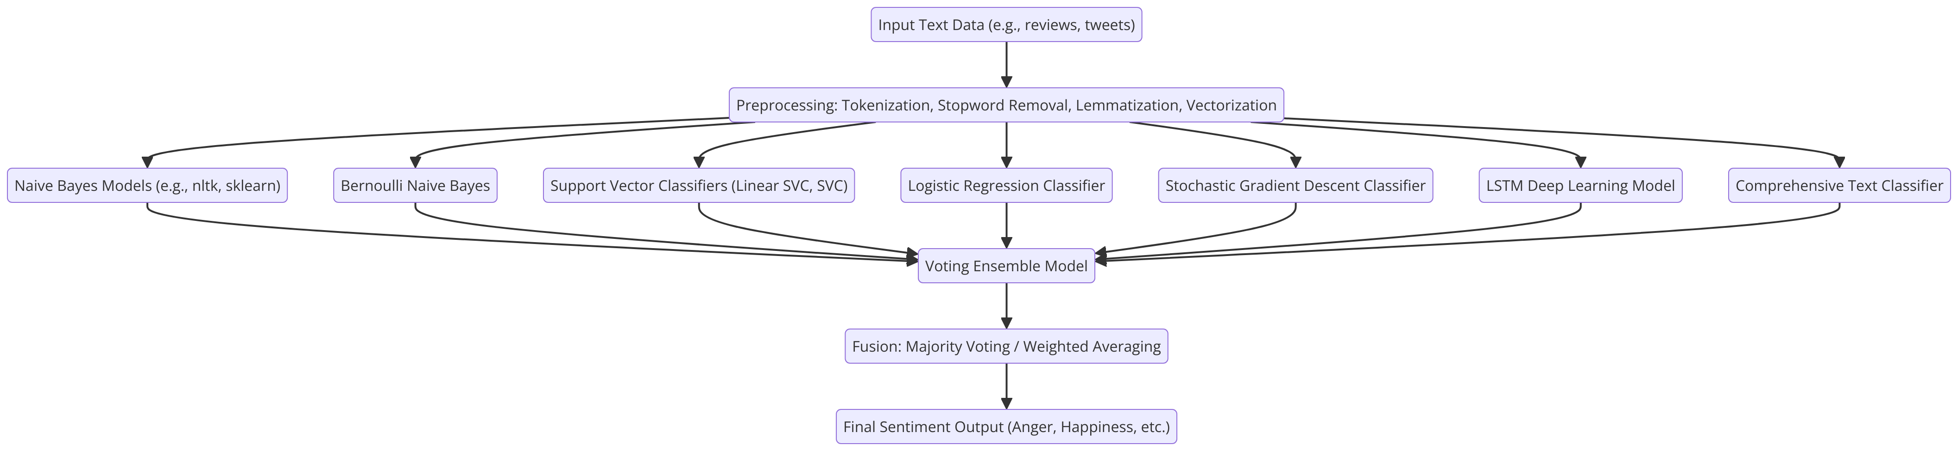
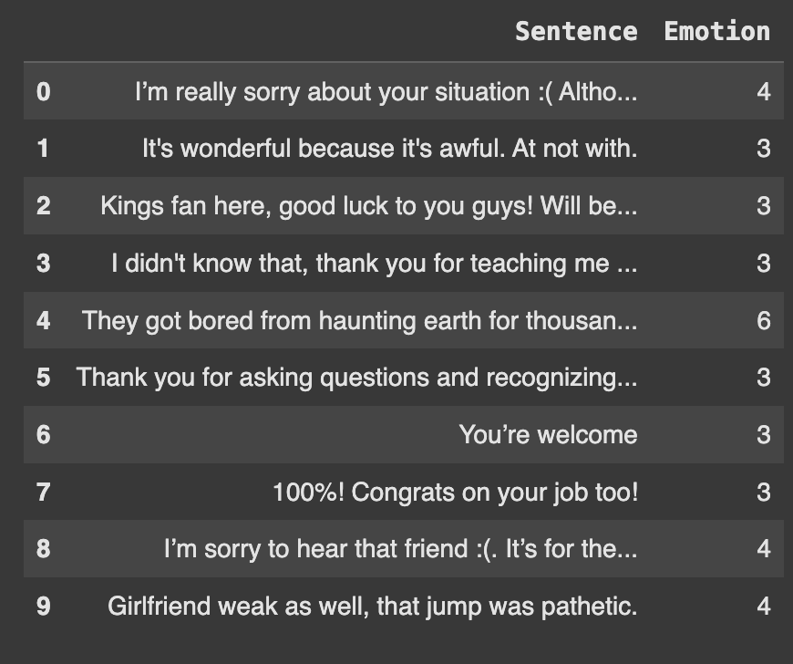
Text-Based Analysis
Model Components
Naive Bayes and Bernoulli Naive Bayes: For simple text classification.
SVM: Identifies hyperplanes for class separation.
LSTM: Captures long-term dependencies in text for contextual understanding.
Voting Ensemble: Combines predictions from all models to generate
final sentiment.

Slide 8
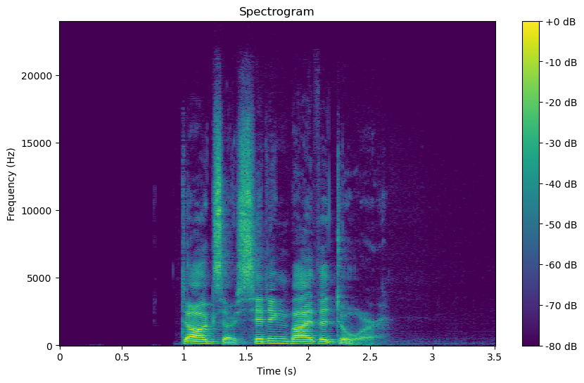
Audio-Based Model
Overview
Focuses on analyzing tonal, pitch, and rhythm-based features in speech.
Preprocessing Steps
Dataset : RAVDESS,CREMA,TESS,SAVEE. total (3142)
Noise Reduction: Filtered out background noise.
Feature Extraction:
MFCCs: Encoded tonal characteristics.
Spectrograms: Represented frequency components over time.
Model Architecture
LSTM Layers: Specialized for processing sequential data.
Captures temporal relationships in speech signals.
Dense Layers: Transforms LSTM outputs into class probabilities.
Key Features
Emotion Detection: Differentiates emotions like happiness, sadness, and anger.
Use Case: Effective in detecting tone during customer feedback or mental health evaluations.
Performance
Accuracy: 88%.
Strength: Robust in identifying strong emotional tones.
Limitation: Sensitive to noisy or low-quality recordings.

Slide 9
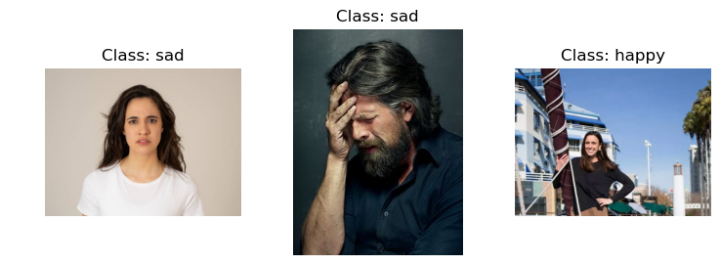
Image-Based Model
Architecture
Convolutional Neural Network (CNN).
Convolutional Layers:
Extract hierarchical features (edges, shapes, patterns).
Pooling Layers:
Downsample feature maps to reduce complexity.
Fully Connected Layers:
Classify sentiment based on extracted features.
Output Layer:
Produces probabilities for sentiment classes (positive, negative, neutral).
Training Process
Preprocessing:
anger: 214 images,fear: 163 images,disgust: 195 images,happy: 230 images,pain: 168 images,sad: 224 images
Resize images to standard dimensions (e.g., 224x224 pixels).
Normalize pixel values (scaling between 0-1).
Augmentation for robustness (flipping, rotation, brightness adjustment).
Evaluation
Accuracy: 85%.
Key Insight:
Effective at identifying facial expressions but struggles with subtle emotions or poor-quality images.

Slide 10
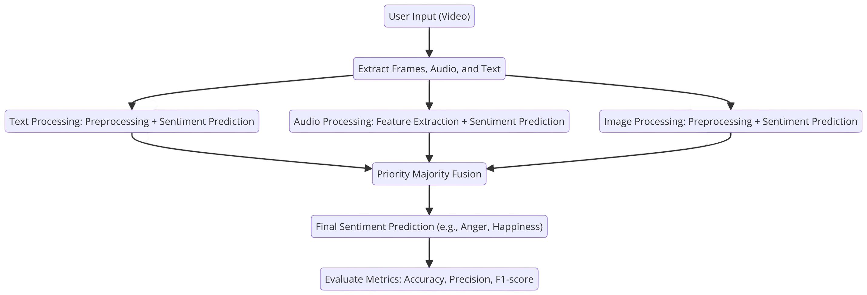
Multi-Modal Fusion Mechanism
Fusion Strategy
Priority-Majority Fusion:
Priority Rule:
Assigns higher confidence to the modality with the strongest prediction.
Majority Voting:
Combines predictions when multiple modalities agree.
Conflict Resolution:
Uses weighted averages of probabilities when modalities disagree.
Implementation
Inputs:
Predictions from text, audio, and image models.
Processing:
Probabilities from each modality are normalized and fused.
Output:
Final sentiment classification.
Performance
Combined Accuracy: 75%.
Strengths:
Resolves ambiguities across modalities.
Handles missing or noisy data effectively.

Slide 11

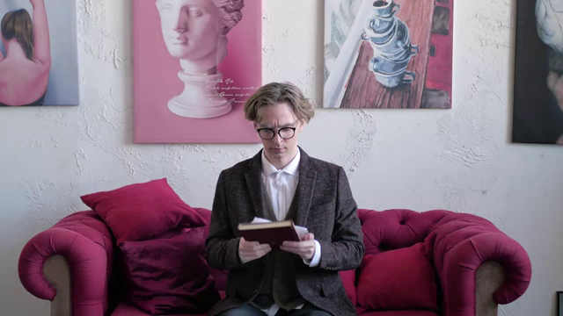

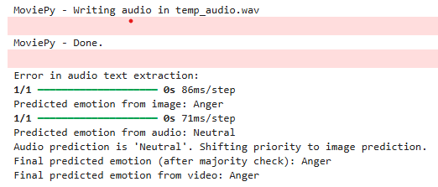
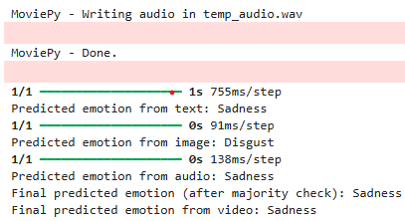
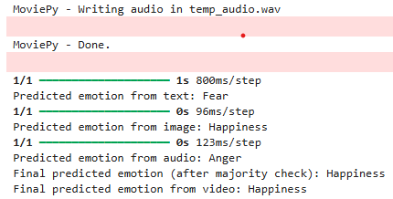
Demonstration of the Model

Slide 12

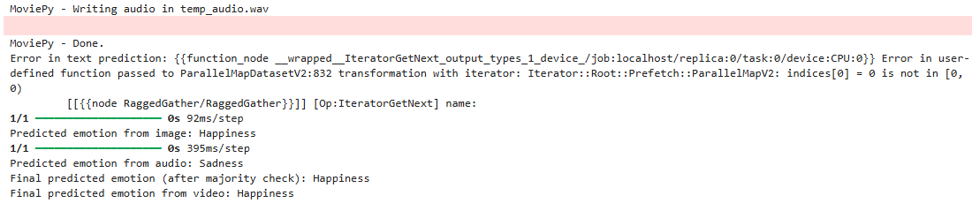

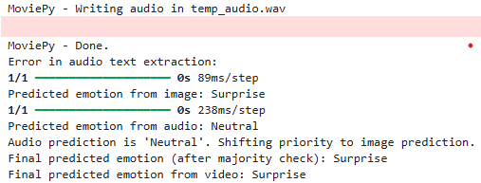
Current drawbacks & Future Work

Slide 13
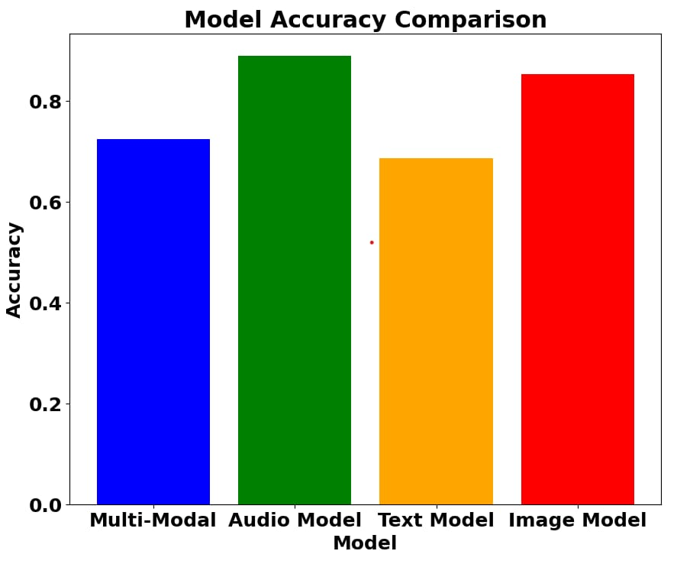
Results and Discussion
Model Performance
Audio: 88%
Text: 64%
Image: 85%
Fusion: 75%
Key Findings
Audio contributes the most.
Image enhances contextual understanding.
Fusion resolves conflicts effectively.

Slide 14
Long Text Handling:
Implement Transformer models (e.g., BERT) for better handling of long sequences.
Speed & Accuracy in Text Model:
Optimize text model for faster predictions and improved efficiency (e.g., DistilBERT).
Fusion with Noisy Data:
Enhance resilience to noisy or incomplete data for more accurate sentiment predictions.
Real-Time Performance:
Optimize for real-time applications with techniques like model pruning and quantization.
Domain-Specific Adaptation:
Fine-tune models for different domains (e.g., healthcare, social media) for better performance.

Slide 15
Thank You

